Slide 1

Should richer countries help in securing food for poor countries?
Rachit Bhatt

Slide 2

Introduction
#Indian
Coding Lover & Tech-Savvy
C# (WPF) Desktop Development – Junior Software Developer
Awarded for Best Technical Solution Provider (Team)

Slide 3
Table of Content
Introduction
Exploring The Topic
Conclusion
Question & Answers
Thank You

Slide 4

Introduction to the topic Should richer countries help in securing food for poor countries?

Slide 5

Food is Vital

Slide 6
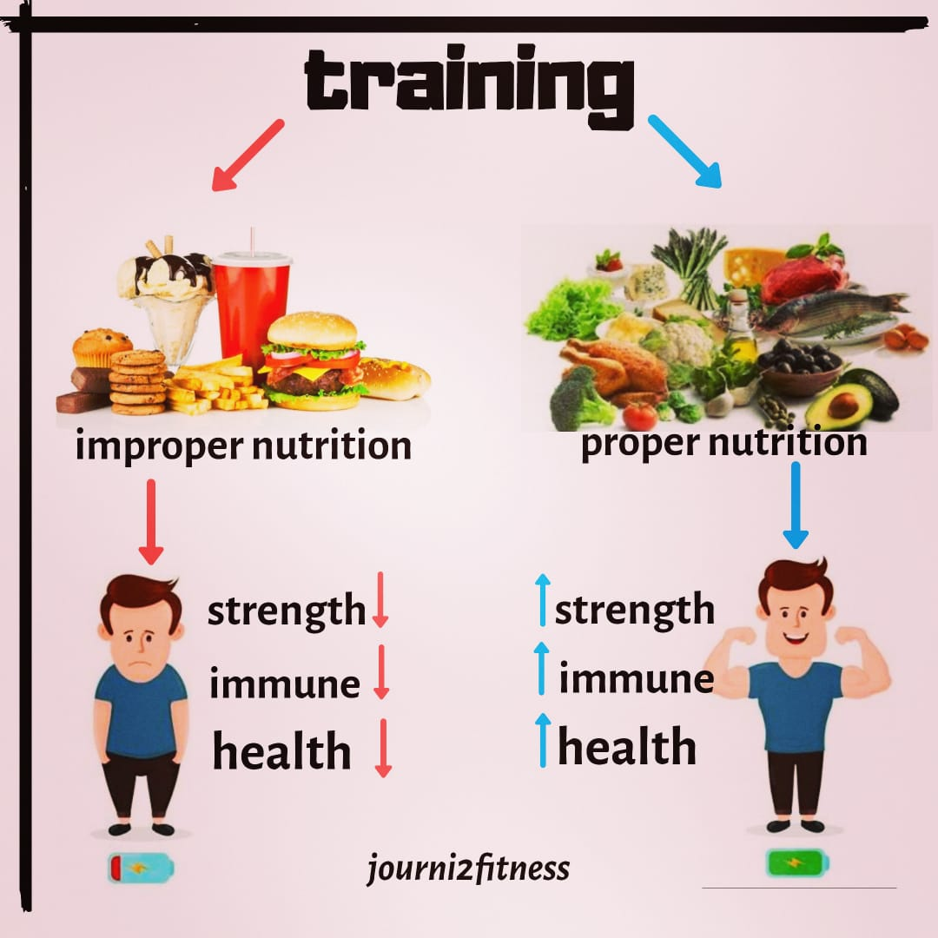
Importance of Food
No Food = No Energy
Not only junk food is improper but also when our eating schedule is disturbed.

Slide 7

Would countries really assist?

Slide 8
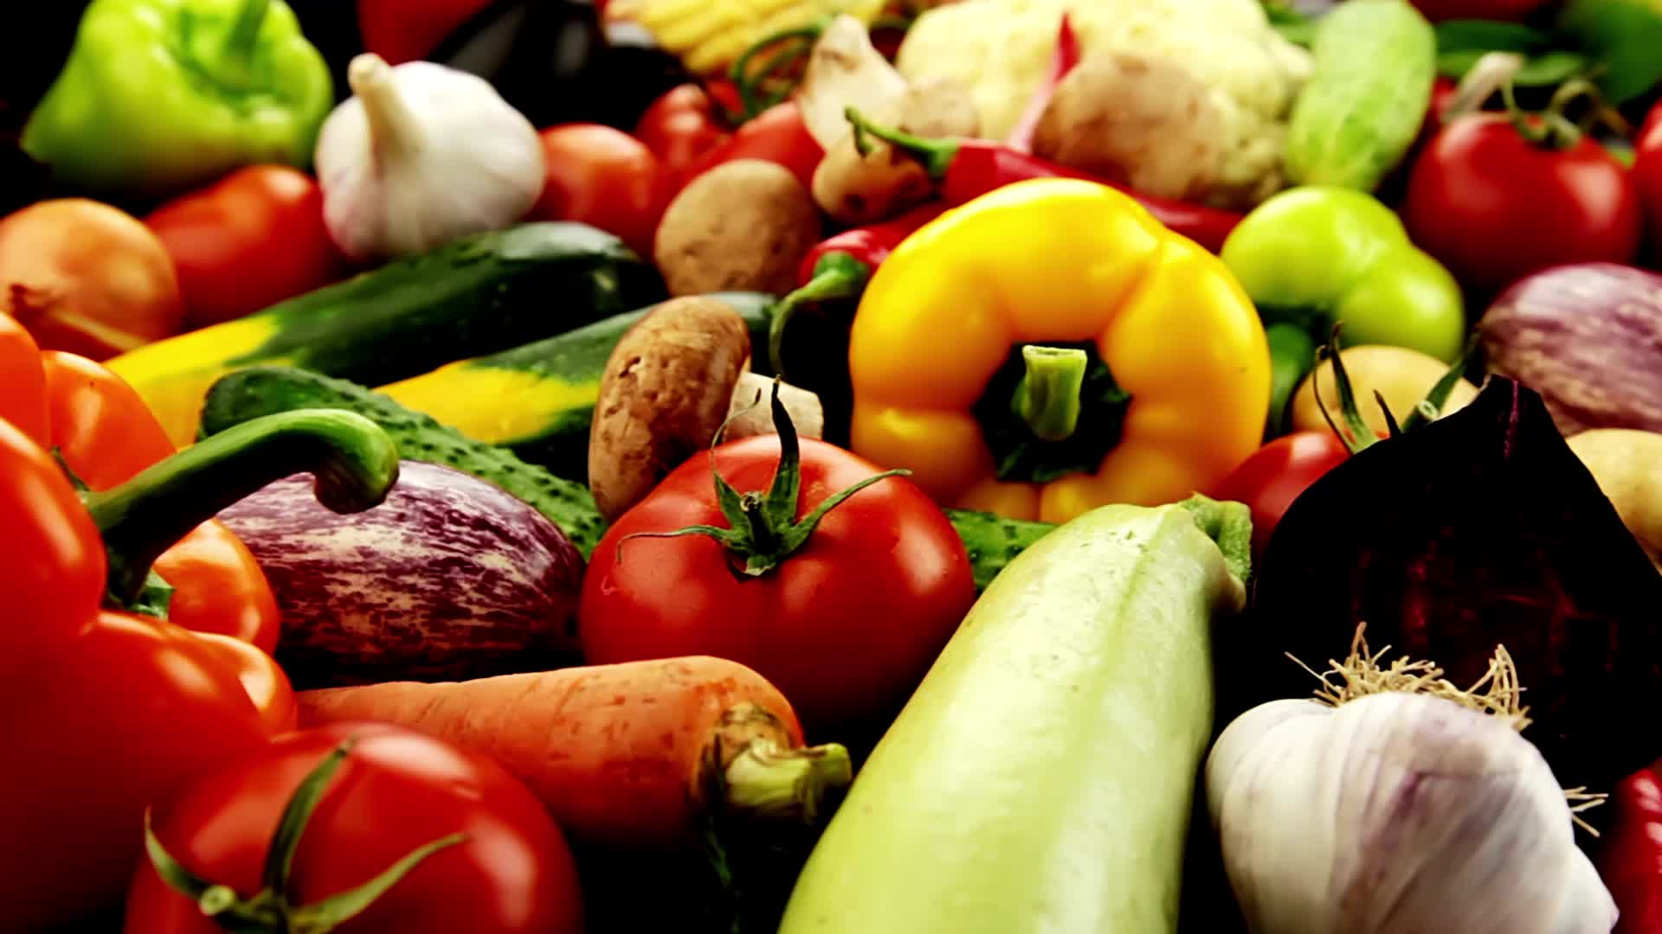
Arguments in Favor of Assistance
Global Responsibility: Some argue that, given the interconnectedness of the global community, wealthier nations have a moral responsibility to assist those in need. This includes helping secure food for poorer countries, especially when they face challenges such as famine, drought, or other food-related crises.
Humanitarian Considerations: Helping for food security aligns with humanitarian principles. It addresses the basic human right to an adequate standard of living, including access to sufficient and nutritious food.
Economic Stability: Ensuring food security in poorer countries can contribute to global economic stability. Hunger and food insecurity can lead to social unrest, migration, and other challenges that may have ripple effects on the global economy.
Long-Term Benefits: Helping poor countries secure food can contribute to long-term stability and development. When people have access to sufficient nutrition, they are better able to work, learn, and contribute to the overall development of their communities and countries.

Slide 9
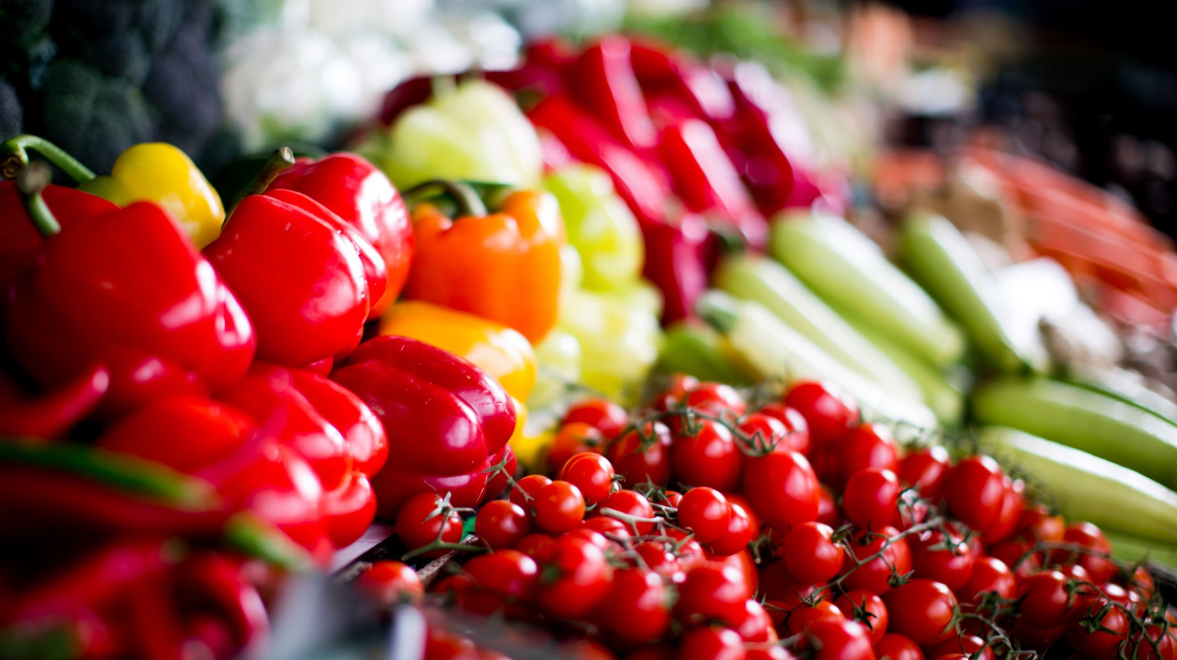
Arguments Against Assistance
Dependency Concerns: Some argue that providing continuous assistance may foster dependency and hinder the development of sustainable agricultural practices and self-sufficiency in poorer nations. Instead of simply providing food aid, efforts should focus on building local capacity and infrastructure.
Market Distortion: Massive food aid from richer nations could potentially distort local markets, making it difficult for local farmers to compete. This can have long-term negative effects on the agricultural sector in the recipient countries.
Political and Governance Issues: In some cases, assistance may be hindered by political instability, corruption, or poor governance in recipient countries. Addressing these issues may be a prerequisite for effective assistance.
Limited Resources: Richer countries may argue that they have limited resources and should prioritize domestic concerns over international aid. They may contend that addressing poverty and hunger requires a multifaceted approach that goes beyond direct food assistance.

Slide 10

Conclusion
In practice, many international organizations, NGOs, and governments strive to strike a balance between providing immediate assistance and supporting long-term development goals. The goal is often to empower communities to achieve food security on their own while providing essential aid during crises.

Slide 11

Questions?

Slide 12

Thank You!

